Slide 1


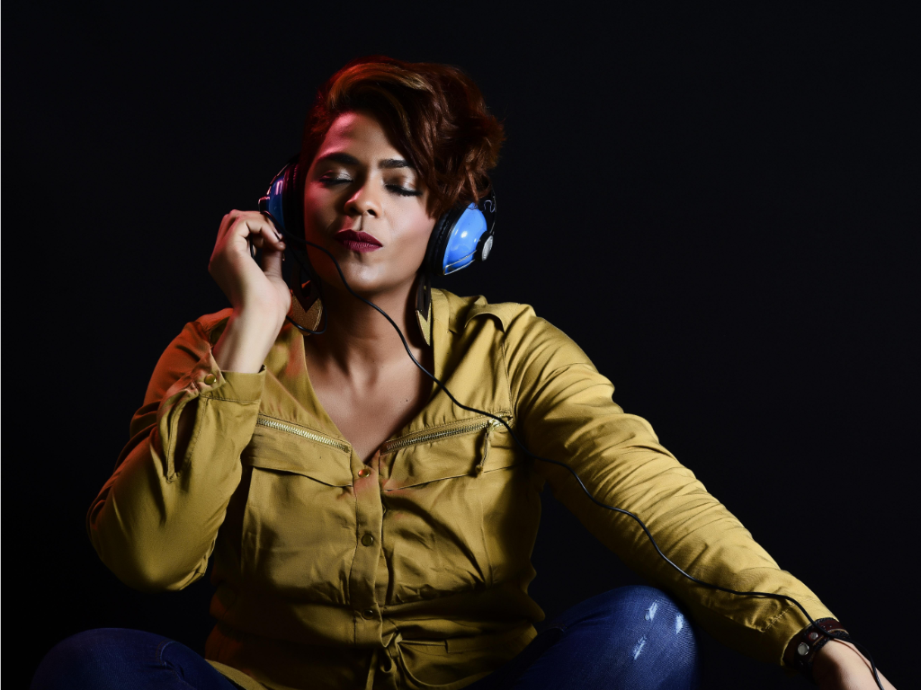
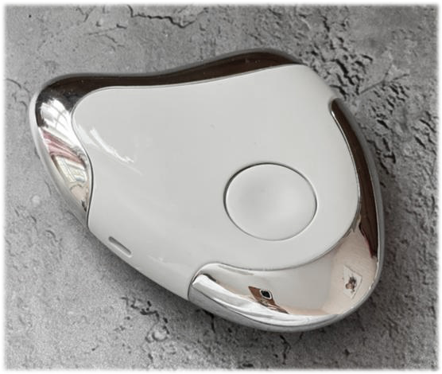
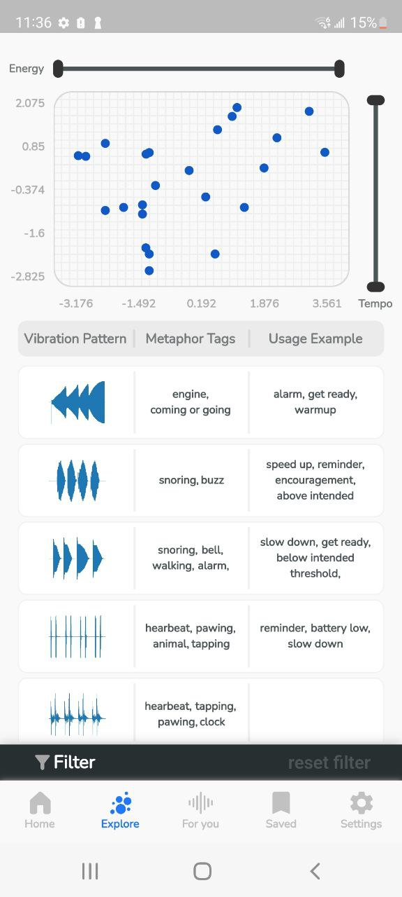






Search
Vibroacustic Therapy
Connect with nature through quality vibroacustic signals
Check out our solution
What is vibroacustic signal?
Vibroacoustic therapy (VAT) is a type of sound therapy that involves passing low frequency signals into the body via a device. Fundamental to vibratory effect is the rhythmicity of music. Scientific studies reports the benefits of using VAT for Parkinson’s, PTSD, anxiety, physical injuries, brain function, Dementia, COPD, Asthma and much more.
Learn more
Quality haptic experiences
Haptic is the sense of touch and it is essential to VAT. A key aspects that sets the sound vibration apart from music is the mechanical stimulation of cells. At SeneScie lab, we use our expertise in haptic science to deliver the state to the art haptic technologies.
Our haptic technology
VAT signal visualization app
SeneScie app enables users to personalize VAT signals for their own preference and utilitarian needs. Some of the key features include:
Access to large VAT signal libraries by means of visualizing vibrations and their descriptive facets
Signal facets and their substructure and linkages
Tuning filters (slider) for VAT signals
Simple personalization tools for end-users to create and save their own signal
Stay connected
Follow us on our social media accounts to get more content.
Copyright Sense Science Lab LTD.
Terms and Conditions Privacy Policy Cookies Contact Us Sitemap

Slide 2
close
Home
Vibroacustic Therapy
Our Solution
About Us
Cart
Vibroacustic Therapy
Connect with nature through quality vibroacustic signals
Check out our solution
What is vibroacustic signal?
Vibroacoustic therapy (VAT) is a type of sound therapy that involves passing low frequency signals into the body via a device. Fundamental to vibratory effect is the rhythmicity of music. Scientific studies reports the benefits of using VAT for Parkinson’s, PTSD, anxiety, physical injuries, brain function, Dementia, COPD, Asthma and much more.
Learn more
Quality haptic experiences
Haptic is the sense of touch and it is essential to VAT. A key aspects that sets the sound vibration apart from music is the mechanical stimulation of cells. At SeneScie lab, we use our expertise in haptic science to deliver the state to the art haptic technologies.
Our haptic technology
VAT signal visualization app
SeneScie app enables users to personalize VAT signals for their own preference and utilitarian needs. Some of the key features include:
Access to large VAT signal libraries by means of visualizing vibrations and their descriptive facets
Signal facets and their substructure and linkages
Tuning filters (slider) for VAT signals
Simple personalization tools for end-users to create and save their own signal
Stay connected
Follow us on our social media accounts to get more content.
Copyright Sense Science Lab LTD.
Terms and Conditions Privacy Policy Cookies Contact Us Sitemap

Slide 3
Search
Search
Vibroacustic Therapy
Scientific Findings
How Does VAT Affect the Body?
The mechanism of action of VAT is the oscillation of the human nervous system with frequencies and resonance characteristics of various muscle groups. VAT combines these resonance frequencies programs based on experimentally based effects, evaluated by patient reactions. Thousands of research hours have taught us how to use these programs to relax, stimulate and relieve pain.
Who Can Benefit From VAT?
VAT may be an independent therapy or incorporated with medical treatment and psychotherapy. As a natural energy booster and pain killer that is composed of varieties of frequencies therapy solutions that can be used as a self-management tool, it is beneficial to people with chronic or special needs, and any person with stress that wants to apply preventive and integrative wellness therapy.
VAT has been studied by researchers worldwide including the National Institutes of Health (NIH). NIH reports the benefits of using VAT for Parkinson’s, PTSD, anxiety, physical injuries, brain function, COPD, Asthma and much more.
Some benefits of VAT include:
• Increase sleep quality
• Reduce or eliminate effects of stress
• Address PTSD / somatic ( physical) symptoms
• Regulate the limbic system (emotional memories)
• Activate the Relaxation Response
• Reduce anxiety and muscle pain or spasms
• Shorten healing periods/increase circulation
Campbell EA, Hynynen J, Burger B, Ala-Ruona E. Exploring the use of Vibroacoustic treatment for managing chronic pain and comorbid mood disorders: A mixed methods study. Nordic Journal of Music Therapy. 2019 Aug 8;28(4):291-314.
Weber A, Busbridge S, Governo R. Evaluation of the Efficacy of Musical Vibroacupuncture in Pain Relief: A Randomized Controlled Pilot Study. Neuromodulation: Technology at the Neural Interface. 2021 Dec 1;24(8):1475-82.
Bartel L, Mosabbir A. Possible mechanisms for the effects of sound vibration on human health. InHealthcare 2021 May 18 (Vol. 9, No. 5, p. 597). MDPI.
Clements-Cortes A, Bartel L. Are we doing more than we know? possible mechanisms of response to music therapy. Frontiers in medicine. 2018:255.
Mosabbir AA, Janzen TB, Al Shirawi M, Rotzinger S, Kennedy SH, Farzan F, Meltzer J, Bartel L. Investigating the Effects of Auditory and Vibrotactile Rhythmic Sensory Stimulation on Depression: An EEG Pilot Study. Cureus. 2022 Feb 24;14(2).
Kantor J, Campbell EA, Kantorová L, Marečková J, Regec V, Karasová K, Sedláčková D, Klugar M. Exploring vibroacoustic therapy in adults experiencing pain: a scoping review. BMJ open. 2022 Apr 1;12(4):e046591.
Stay connected
Stay connected
Follow us on our social media accounts to get more content.
Follow us on our social media accounts to get more content.
Copyright Sense Science Lab LTD.
Copyright Sense Science Lab LTD.
Terms and Conditions Privacy Policy Cookies Contact Us Sitemap
Terms and Conditions Privacy Policy Cookies Contact Us Sitemap

Slide 4
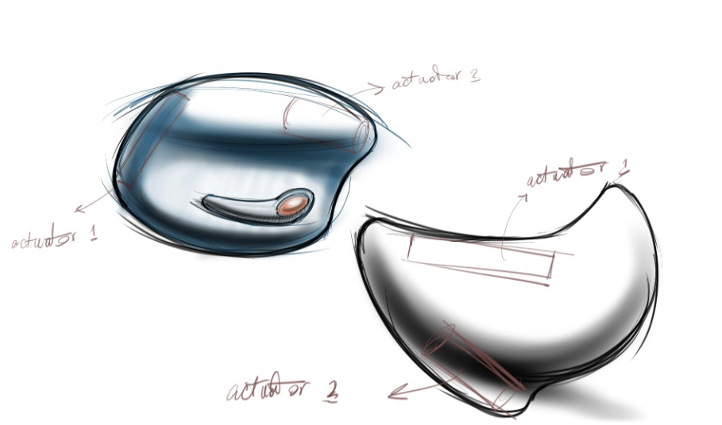
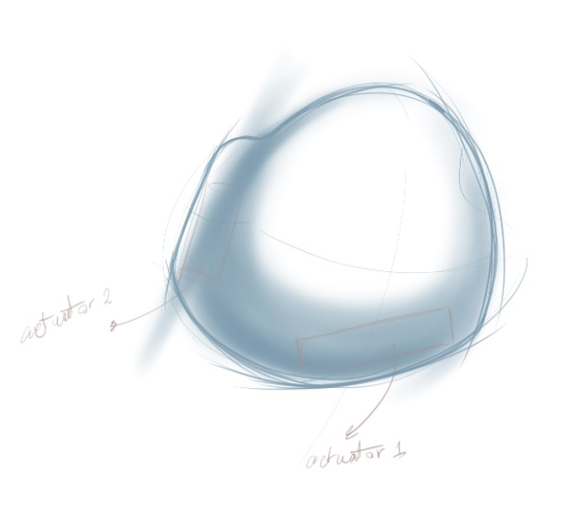
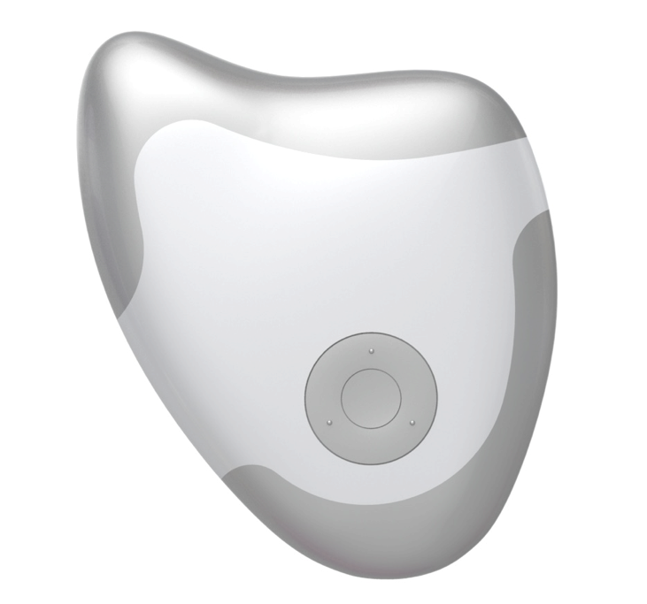
Search
The SenScie’s Story
Our Mission
Our Technology
Stay connected
Follow us on our social media accounts to get more content.
Copyright Sense Science Lab LTD.
Terms and Conditions Privacy Policy Cookies Contact Us Sitemap

Slide 5
Search
Product
Shipping
Stay connected
Follow us on our social media accounts to get more content.
Copyright Sense Science Lab LTD.
Terms and Conditions Privacy Policy Cookies Contact Us Sitemap

Slide 6
Search
Refund policy
We understand how challenging it is to shop online. We acknowledge the difficulties you may have in trusting a new brand. We are here to promise you consistency, great quality and accountability for our products.
If you have received your purchase and would like to return or exchange it, please follow the instructions below and send us an email to support@banumagnifique.com to inform us about it.
You will have 30 days to return your item(s). If 30 days have gone by since your purchase, unfortunately we can’t offer you a refund or exchange. Please note:
• To be eligible for a refund or an exchange, your item must be unused and in the same condition that you received it. It must also be in the original packaging.
• To complete your return, we require a receipt or proof of purchase.
• You are responsible for paying for your own shipping costs for returning your item(s).
• To return your product, you should mail your product to: suite 471 – 1231 Pacific Blvd, Vancouver, BC, V6Z 0E2, Canada.
Full Refunds (if applicable)
Once your return is received and inspected, we will send you an email to notify you that we have received your returned item. We will also notify you of the approval or rejection of your refund. If you are approved, then your refund will be processed, and a credit will automatically be applied to your credit card or original method of payment, within a certain amount of days.
Late or missing refunds (if applicable)
If you haven’t received a refund yet, first check your bank account again. Then contact your credit card company, it may take some time before your refund is officially posted. Next contact your bank. There is often some processing time before a refund is posted.
If you’ve done all of this and you still have not received your refund yet, please contact us at support@banumagnifique.com.
Exchanges (if applicable)
We only replace items if they are defective, damaged, or a wrong size. If you need to exchange it for the same item, send us an email at support@banumagnifique.com and send your item to: suite 471 – 1231 Pacific Blvd, Vancouver, BC, V6Z 0E2, Canada. Please note you are responsible for paying for the shipping costs for returning the item.
Shipping Your Items
To return your product, you should mail it to: suite 471 – 1231 Pacific Blvd, Vancouver, BC, V6Z 0E2, Canada.
Depending on where you live, the time it may take for your exchanged product to reach you, may vary.
If you are shipping an item over $75, you should consider using a trackable shipping service or purchasing shipping insurance. We don’t guarantee that we will receive your returned item.
Stay connected
Follow us on our social media accounts to get more content.
Copyright Sense Science Lab LTD.
Terms and Conditions Privacy Policy Cookies Contact Us Sitemap

